Slide 1

Flight Delay and Cancellation Analysis
BY:- AmaN
Kalpesh
pritesh
chetan

Slide 2
Introduction
Goal: To analyze a dataset of flights to identify the primary reasons for delays and cancellations.
Dataset: We're using a dataset containing detailed information on various flights, including departure times, arrival times, and specific delay reasons.
Key Questions:
What are the most common causes of flight delays?
Which airlines are punctual?
Which airlines have the highest average departure & arrival delays?

Slide 3
Data Overview & Preparation
Raw Data: The dataset included multiple variables such as flight numbers, airlines, airports,
and various delay metrics.
Data Cleaning: Before analysis, the data was cleaned to handle common issues:
Duplicates were removed to ensure accuracy.
Found various null values in almost each column.
Missing values were filled in or replaced with zeros where appropriate.
Data types were corrected to allow for proper calculation and comparison.

Slide 4
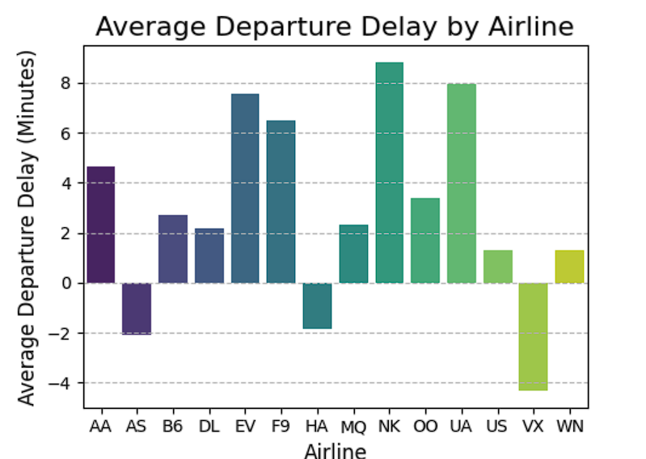
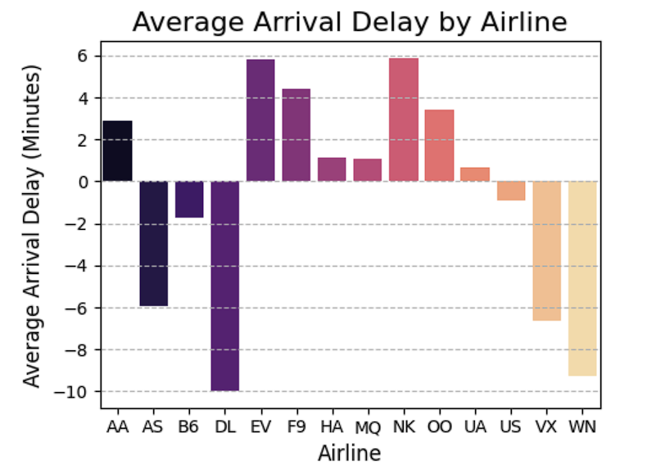
Average Delays of each Airline

Slide 5
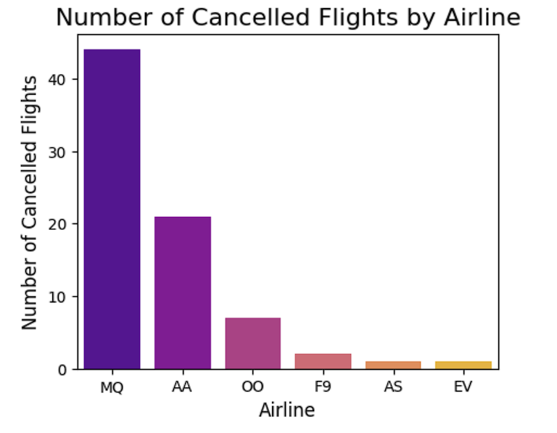
Total Cancelled Flight
The Bar chart shows total flight cancelled by each airline companies in year 2015.

Slide 6
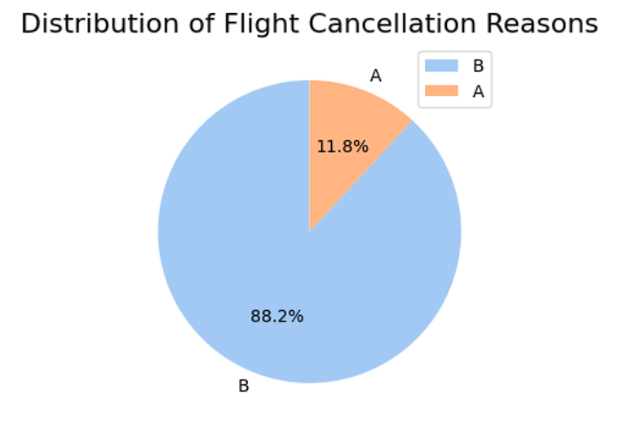
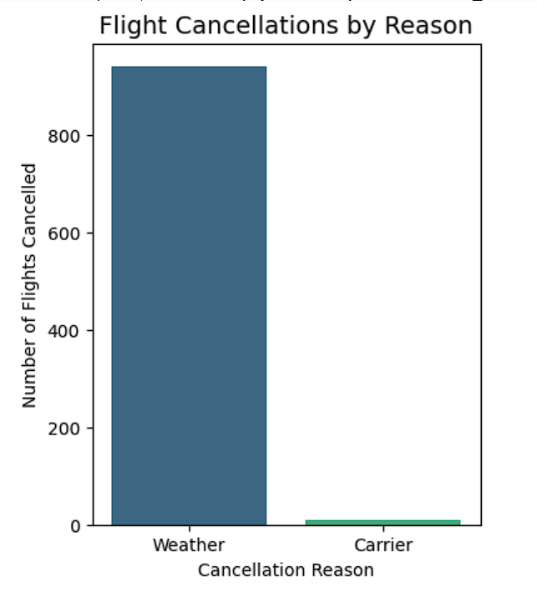
The main reason behind flight cancellation.

Slide 7
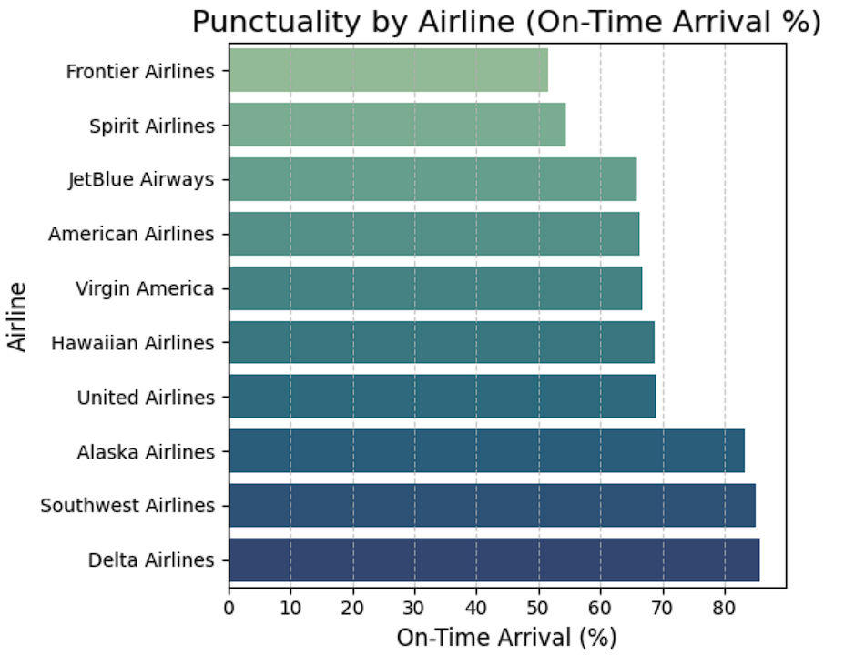
Most Punctual Airline
This horizontal bar chart shows which airline service is most punctual in terms of arrival time

Slide 8
Conclusion
We cleaned , transformed and analyzed airlines data to get insight about why flights delay ,why most of the flight get cancelled what's the main reason behind the flight cancellation .In this process we used python’s core concepts as well as libraries like pandas, numpy , matplotlib, seaborn etc.

Slide 9
THANK YOU….

